Slide 1
Investigating Relationships between Attitudes toward the use of Web 2.0 Technologies and Mathematical Achievement
(Paper 2 of 3)
Dr. Mokter Hossain
University of Alabama &
University of Nevada, Reno
&
Dr. Robert Quinn
University of Nevada, Reno
24th SITE International Conference-2013
New Orleans, LA, USA, March 25-29, 2013

Slide 2
Investigating Relationships between Attitudes toward the use of
Web 2.0 Technologies and Mathematical Achievement
The Organization of this Presentation
INTRODUCTION
OBJECTIVE OF THE STUDY
RESEARCH QUESTIONS
PROCEDURE OF THE STUDY
PARTICIPANTS AND DATA
FINDINGS
IMPLICATIONS OF THE STUDY
CONCLUSION

Slide 3
Investigating Relationships between Attitudes toward the use of
Web 2.0 Technologies and Mathematical Achievement
Introduction
Technology has been a powerful tool in the United States’ mathematics classrooms
Technology use is emphasized in the NCTM (2000) Principles and Standards for School Mathematics, in the United States
However, use of technology is not available and effective at all levels; especially in teacher education programs
Increasing demand of mathematics teaching-learning software and web-based programs
High cost/annual license fee; and high configuration computers
Young students’ trends on social networking sites
Expectation of free, anywhere, anytime and easy to use programs

Slide 4
Investigating Relationships between Attitudes toward the use of
Web 2.0 Technologies and Mathematical Achievement
Introduction…
Web 2.0 technology has a great potential to meet these demands
Web 2.0 is a collaborative Web development platform
It Could establish new dimensions to enhance Math Education
Web 2.0 technologies have many Interactive Features
Most of the Web 2.0 applications are free of very low cost
Expectation of free, anywhere, anytime and easy to use programs
Users can add, control, and share information interactively and simultaneously on the Web, mostly for free
Creating and editing most Web 2.0 applications is free, fast, and requires only basic computing knowledge

Slide 5
Investigating Relationships between Attitudes toward the use of
Web 2.0 Technologies and Mathematical Achievement
Objective and Significance of the Study
Investigating Relationships between Attitudes toward the use of Web 2.0 Technologies and Mathematical Achievement
As a standard example of Web 2.0 application, Blog was Selected as a supportive Teaching-Learning Tool
Use of a Blog might be a new dimension of using technology
Most of the Participants were Preservice Mathematics Teachers
Results may be useful for Math Students, Teachers, & Educators

Slide 6
Investigating Relationships between Attitudes toward the use of
Web 2.0 Technologies and Mathematical Achievement
Research Questions
Research Question 1: Is there a relationship between the cumulative quiz scores attained by preservice mathematics teachers enrolled in a college Euclidean Geometry class and their attitudes toward the blogging activity in a college Euclidean Geometry class?
Research Question 2: Is there a relationship between the cumulative quiz scores attained by preservice mathematics teachers enrolled in a college Euclidean Geometry class and their perceptions of the effectiveness of the blog for the learning of Euclidean Geometry?

Slide 7
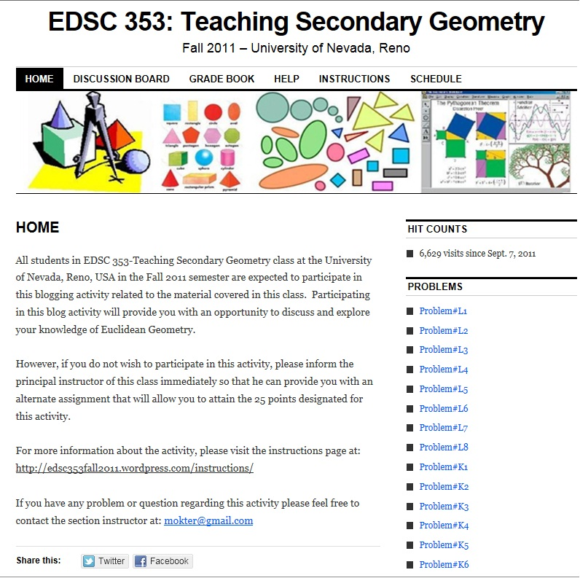
Investigating Relationships between Attitudes toward the use of
Web 2.0 Technologies and Mathematical Achievement
Procedure
of the Study

Slide 8
Investigating Relationships between Attitudes toward the use of
Web 2.0 Technologies and Mathematical Achievement
METHODOLOGY
Working Definitions of the Dependent Variables
Dependent Variables:
Participants’ attitudes scores – measured by calculating the median response to the 16 Likert-type items on a six-point scale;
Participants’ perceived effectiveness scores– measured by calculating the median response to another 18 Likert-type scale items on a six-point scale; and
Participants’ cumulative quiz scores attained on eight in-class quizzes.

Slide 9
Investigating Relationships between Attitudes toward the use of
Web 2.0 Technologies and Mathematical Achievement
Participants and Data
Table: Descriptive Statistics of Participants’ Age and Median Attitude and Perceived Effectiveness Scores
 |  |  | Age | Median Attitude Scores | Median Perceived Effectiveness
N | Male | 12
 | Female | 16
 | Total | 28
Mean |  |  | 26.43 | 4.1786 | 4.1250
Median |  |  | 22.00 | 4.0000 | 4.0000
Mode |  |  | 20ª | 4.00 | 4.00
Std. Deviation |  |  | 10.149 | .95466 | .92921
a. Multiple modes exist. The smallest value is shown

Slide 10
Investigating Relationships between Attitudes toward the use of
Web 2.0 Technologies and Mathematical Achievement
Results:
Research Question 1: There was no significant relationship between the cumulative quiz scores attained by preservice mathematics teachers enrolled in a college Euclidean Geometry Course and their attitudes toward the blogging activity in a college Euclidean Geometry Course
Table: Spearman Correlation Test Results on Median Attitude Scores
Spearman's rho |  | Cumulative Quiz Score | r_{s}
Cumulative Quiz Score | Correlation Coefficient | 1.000 | -.145
 | Sig. (2-tailed) | . | .461
 | N | 28 | 28
Median Attitudes | Correlation Coefficient | -.145 | 1.000
 | Sig. (2-tailed) | .461 | .
 | N | 28 | 28
(N = 28, r_{s} = -0.145, p = .461 >.05); Non-Significant

Slide 11
Investigating Relationships between Attitudes toward the use of
Web 2.0 Technologies and Mathematical Achievement
Results:
Research Question 3b: There was no significant relationship between the cumulative quiz scores attained by preservice mathematics teachers enrolled in a college Euclidean Geometry Course and their perceptions of the effectiveness of the blog for the learning of Euclidean Geometry
Table: Spearman Correlation Test Results on Median Perceived Effectiveness Scores
Spearman's rho |  | Cumulative Quiz Score | r_{s}
Cumulative Quiz Score | Correlation Coefficient | 1.000 | -.232
 | Sig. (2-tailed) | . | .235
 | N | 28 | 28
Median Effectiveness | Correlation Coefficient | -.232 | 1.000
 | Sig. (2-tailed) | .235 | .
 | N | 28 | 28
(N = 28, r_{s} = -0.232, p = .235 >.05); Non-Significant

Slide 12
Investigating Relationships between Attitudes toward the use of
Web 2.0 Technologies and Mathematical Achievement
Implications for Practice
Preservice teachers found it positive and effective
New teaching-learning tool – could be included in the schools, and teacher education curricula
Can develop collaborative teaching-learning environment
A free and public forum for online discussion

Slide 13
Investigating Relationships between Attitudes toward the use of
Web 2.0 Technologies and Mathematical Achievement
Limitations and Delimitations
The study dealt with a single class of 28 students
The study has only about 51% chance of finding a significant mean difference between the groups, if it really existed
Euclidean Geometry problems that required participants using construction tools or uploading of images and graphs were avoided
Participants were asked to type mathematical formulas in plain text format
Did not use a control/experimental group
Did not measure the instructor’s perceptions

Slide 14
Investigating Relationships between Attitudes toward the use of
Web 2.0 Technologies and Mathematical Achievement
Recommendations for Further Research
Replication of this study in another college Euclidean Geometry Course
Replication of this study in a online college Euclidean Geometry Course
Replication of this study in a high school Euclidean Geometry Course
Conduct the quantitative and qualitative components in different ways
Improve the instruments used in the present study.

Slide 15
Investigating Relationships between Attitudes toward the use of
Web 2.0 Technologies and Mathematical Achievement
Conclusions
Use of a blog in a College Euclidean Geometry Course is enjoyable and effective
No significant difference in the measures of attitude and perceived effectiveness on Participants Achievement scores
Collaborative, motivational; anytime, anywhere, easy accessible
Participants found blog as an open and public forum
Numerous potential to improve teaching-learning mathematics

Slide 16

Investigating Relationships between Attitudes toward the use of
Web 2.0 Technologies and Mathematical Achievement
QUESTIONS & ANSWERS??
Please Discuss Online;
Or, Email at: mokter@gmail.com
Thank You

